Slide 1
JAVA PROGRAMMING
-Balasuriya.K
(1380824)
GE Healthcare

Slide 2

What is JAVA?
Object-oriented programming language developed in 1995.
James Gosling initially developed Java.
Combination of C and C++.
Java programs are platform independent.
Write Once Run Anywhere (WORA).

Slide 3



Where is java being used?
Web Application.
Desktop Application.
Enterprise Application.
Mobile Application.

Slide 4
History and evolution of JAVA
Problems faced in previous programming languages.
It took 18 months to develop and had an initial name as Oak which was renamed to Java in 1995, due to copyright issues.
JDK1.0 23 Jan 1996 - Java SE 10 (18.3) 2018.

Slide 5
JAVA Programming Structure
Documentation Section
Package Statement
Import Statements
Class Definition
Main Method Definition

Slide 6
Simple program to understand the structure
/*This is sample program
Start of program*/
package com; // package statements
import java.lang.*; // import statements
public class findNumbers{ // Class definition
public static void main (String args[]){ // Main method definition
int x,y;
int sum=10;
int diff=20;
x=(sum+diff)/2;
System.out.println(x);
y=(sum-diff)/2;
System.out.println(y);
}
}
/* End of program */

Slide 7
JAVA Environment
JVM (JAVA VIRTUAL MACHINE).
JRE (JAVA Runtime Environment)
JDK (JAVA Development Kit)

Slide 8
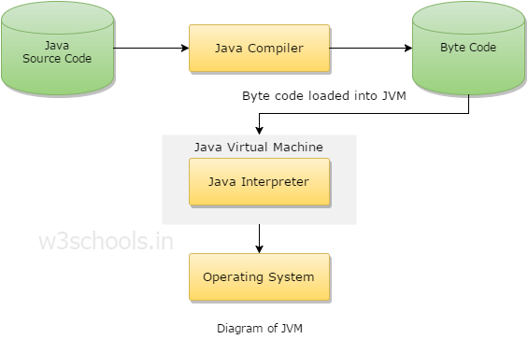
JAVA Virtual Machine
Reading Bytecode.
Verifying bytecode.
Linking the code with the library.

Slide 9
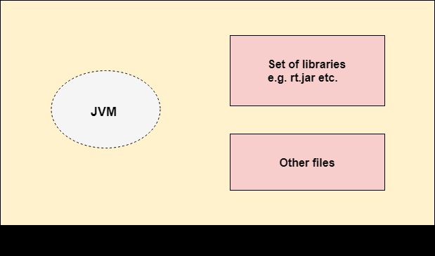
JAVA Runtime Environment
JRE is a set of software tools for the development of Java applications
You need JRE to execute your program, which includes two things:
JVM
Java Library
Static & Dynamic Functions

Slide 10
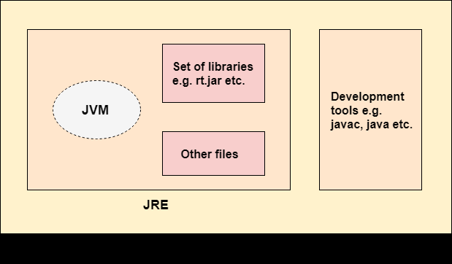
JAVA Development Kit
JDK is an Implementation of any one JAVA platforms below
Standard Edition Java Platform
Enterprise Edition Java Platform
Micro Edition Java Platform
It contains
Java Virtual Machine (JVM).
Java class library.
Interpreter/Loader (Java).
Compiler (javac), etc.

Slide 11
Let's try a simple code in IDE

Slide 12
RECALL
Java programs are platform independent
Object-oriented programming language
Java programming Structure
Documentation Section
Package Statement
Import Statements
Class Definition
Main Method Definition
JDK

Slide 13
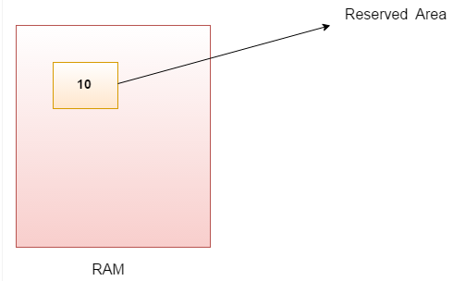
JAVA Variables
A variable is a container which holds the value while the java program is executed
A variable is assigned with a datatype.
"vary + able"

Slide 14
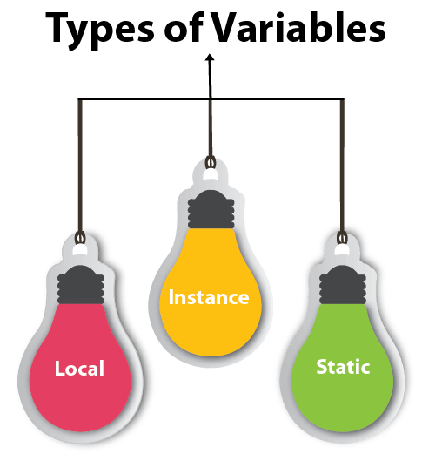
Types of variables
A variable declared inside the body of the method is called local variable.
A variable declared inside the class but outside the body of the method, is called instance variable.
A variable which is declared as static is called static variable.

Slide 15
Example to understand variables better
class A{
int data=50;
static int m=100;
void method(){
int n=90;
}
} //end of class
instance variable
static variable
local variable

Slide 16
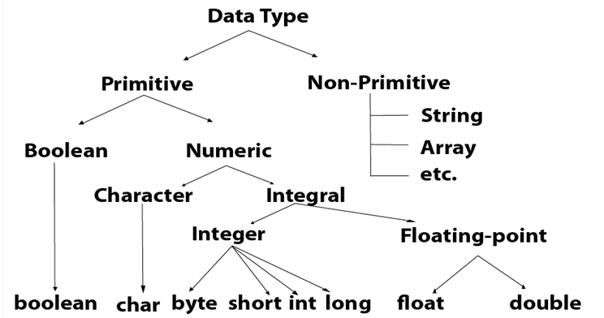
Datatypes
Data types specify the different sizes and values that can be stored in the variable

Slide 17
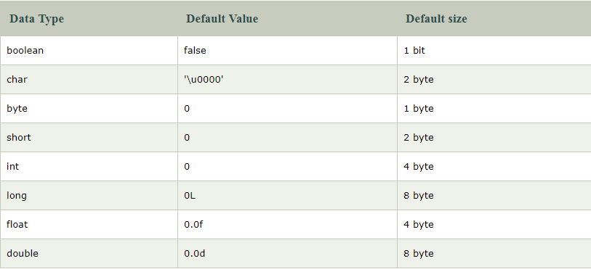
Primitive DataTypes

Slide 18
Primitive Datatypes Example
boolean one = false;
byte b = -20;
short s = 10000;
int a = 100000;
long a = 100000L;
float f = 234.5f;
double d = 12.3;
char letterA = 'A';

Slide 19
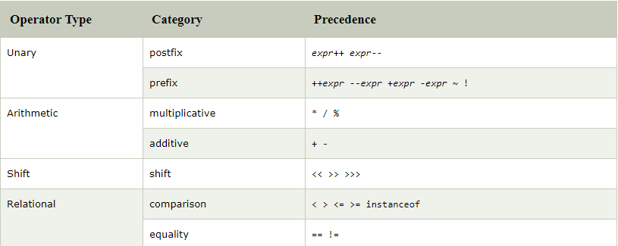
Operators in Java
Operator in java is a symbol that is used to perform operations. For example: +, -, *, / etc.

Slide 20
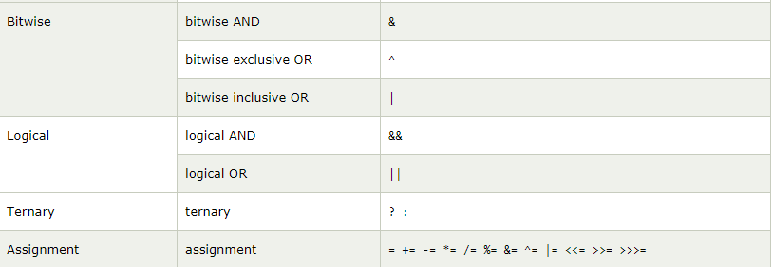

Slide 21
Unary Operator
Output:
10
12
12
10
class OperatorExample{
public static void main(String args[]){
int x=10;
System.out.println(x++);
System.out.println(++x);
System.out.println(x--);
System.out.println(--x);
}}

Slide 22
Unary ! Operator
class OperatorExample{
public static void main(String args[]){
boolean c=true;
boolean d=false;
System.out.println(!c); //false (opposite of boolean value)
System.out.println(!d); //true
}}

Slide 23
Arthimetic operators
class OperatorExample{
public static void main(String args[]){
int a=10;
int b=5;
System.out.println(a+b);//15
System.out.println(a-b);//5
System.out.println(a*b);//50
System.out.println(a/b);//2
System.out.println(a%b);//0
}}

Slide 24
Assingnment Operator
public class ChainAssign {
public static void main(String args[]) {
int a, b, c;
a = b = c = 100; // set a, b, and c to 100
System.out.println("a = " + a);
System.out.println("b = " + b);
System.out.println("c = " + c);
}
}
a = 100
b = 100
c = 100

Slide 25
Relational Operator
public class relatiop {
public static void main(String[] args) {
int num1 = 12, num2 = 4;
System.out.println((num1 == num2));
System.out.println((num1 != num2));
System.out.println((num1 > num2));
System.out.println((num1 < num2));
System.out.println((num1 >= num2));
System.out.println((num1 <= num2));
}
}
Output
false
true
true
false
true
false

Slide 26
Left shift Operator
The Java left shift operator << << indicates the bits are to be shifted to the left.
class OperatorExample{
public static void main(String args[]){
System.out.println(10<<2); //10*2^2=10*4=40
System.out.println(10<<3); //10*2^3=10*8=80
System.out.println(20<<2); //20*2^2=20*4=80
}}

Slide 27
Right shift operator
The Java right shift operator >> indicates the bits are to be shifted to the right
class OperatorExample{
public static void main(String args[]){
System.out.println(10>>2);//10/2^2=10/4=2
System.out.println(20>>2);//20/2^2=20/4=5
System.out.println(20>>3);//20/2^3=20/8=2
} }

Slide 28
AND Operator ( Logical && and Bitwise &)
class OperatorExample{
public static void main(String args[]){
int a=10;
int b=5;
int c=20;
System.out.println(a<b&&a++<c);//false && true = false
System.out.println(a);//10
System.out.println(a<b&a++<c);//false && true = false
System.out.println(a);//11
}}

Slide 29
OR Operator Logical || and Bitwise |
class OperatorExample{
public static void main(String args[]){
int a=10;
int b=5;
int c=20;
System.out.println(a>b || a<c);//true || true = true
System.out.println(a>b | a<c);//true | true = true
}}

Slide 30
Tenary Operator
class OperatorExample{
public static void main(String args[]){
int a=2;
int b=5;
int min=(a<b)?a:b;
System.out.println(min);
}}
Output
2

Slide 31
TRY IT OUT
Try out a simple Java Program satisfying the below condition
Declare a local variable,static variable and instance Variable (using all datatypes available)
Try to use all operators and build a simple Calculator program in eclipse IDE
Use ClassName as calculator_Demo
Use packageName as day2_Demo

Slide 32
RECALL
Variables - static ,local, instance
DataTypes - int , float ,char , boolean
Operators and its types
Relational operator
Incremental operator( postfix and prefix)
& and | operator
Tenary Operator

Slide 33
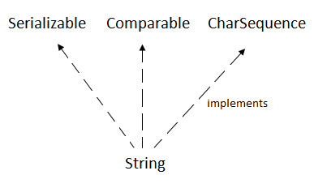
Non Primitive Datatypes (Strings)
String is basically an object that represents sequence of char values
java.lang.String

Slide 34
Non Primitive Datatypes (Strings)
How to create a string object?
There are two ways to create String object:
By string literal
By new keyword

Slide 35
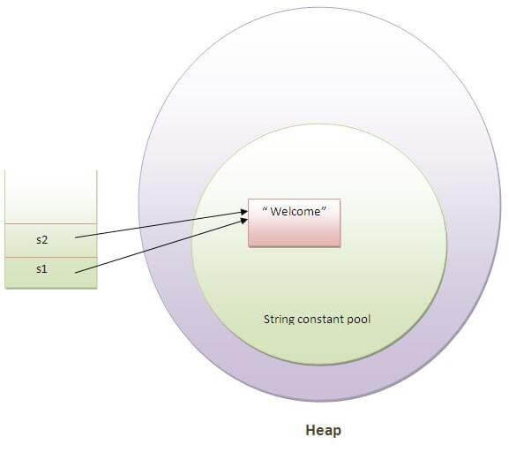
String literal
String s1="Welcome";
String s2="Welcome";

Slide 36
String creation-By new keyword
public class StringExample{
public static void main(String args[]){
String s1="java";//creating string by java string literal
char ch[]={'s','t','r','i','n','g','s'};
String s2=new String(ch);//converting char array to string
String s3=new String("example"); //creating java string by new keyword
System.out.println(s1);
System.out.println(s2);
System.out.println(s3);
}}
Output
java
strings
example

Slide 37
Java String class methods
Method | Description
char charAt(int index) | returns char value for the particular index
int length() | returns string length
String substring(int beginIndex) | returns substring for given begin index.
String substring(int beginIndex, int endIndex) | returns substring for given begin index and end index.
boolean contains(CharSequence s) | returns true or false after matching the sequence of char value.
boolean equals(Object another) | checks the equality of string with the given object.
boolean isEmpty() | checks if string is empty.
String concat(String str) | concatenates the specified string.
String replace(char old, char new) | replaces all occurrences of the specified char value.

Slide 38
Method | Description
String replace(CharSequence old, CharSequence new) | replaces all occurrences of the specified CharSequence.
String equalsIgnoreCase(String another) | compares another string. It doesn't check case.
String[] split(String regex) | returns a split string matching regex.
int indexOf(int ch) | returns the specified char value index.
int indexOf(int ch, int fromIndex) | returns the specified char value index starting with given index.
int indexOf(String substring) | returns the specified substring index.
int indexOf(String substring, int fromIndex) | returns the specified substring index starting with given index.
String toLowerCase() String toUpperCase() | returns a string in lowercase. returns a string in uppercase.
String trim() | removes beginning and ending spaces of this string.

Slide 39
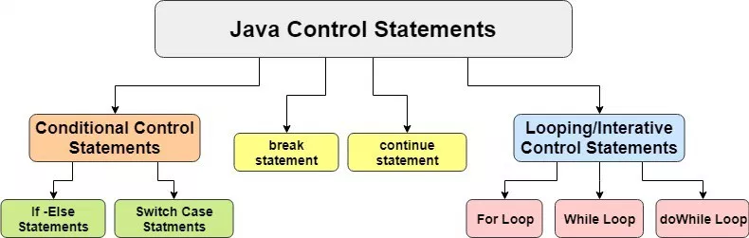
Control statements in JAVA

Slide 40
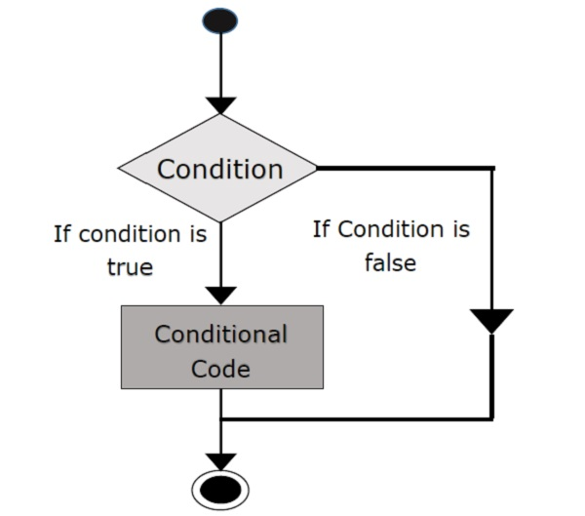
Java If Statement
Syntax :
if(condition) {
//code to be executed
}

Slide 41
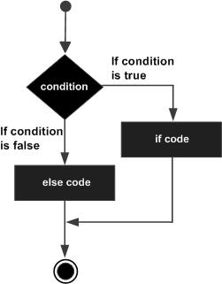
JAVA if-else statement
Syntax:
if(condition){
//code if condition is true
}
else{
//code if condition is false
}

Slide 42
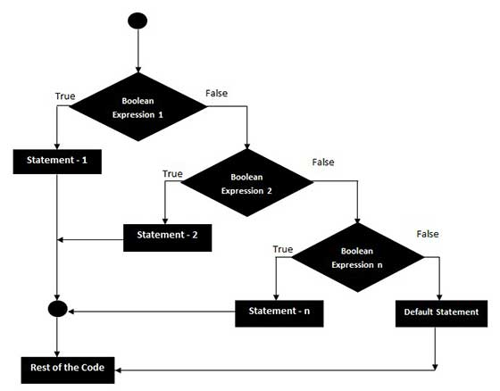
JAVA else-if ladder statement
Syntax :
if(condition1){
//code to be executed if
}
else if(condition2){
//code to be executed if
}
else if(condition3){
//code to be executed if
}
else{
//code to be executed if all
}

Slide 43
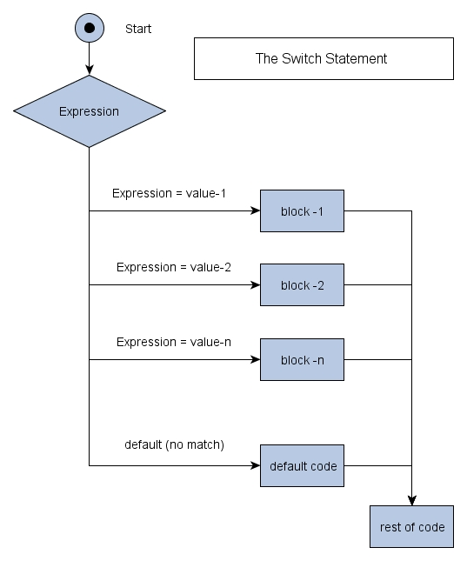
Switch statement
Syntax:
switch(expression){
case value1:
//code to be executed;
break; //optional
case value2:
//code to be executed;
break; //optional
default:
code to be executed if all cases are not matched;
}

Slide 44
Java Break Statement
When a break statement is encountered inside a loop, the loop is immediately terminated and the program control resumes at the next statement following the loop.
It breaks the current flow of the program at specified condition.
public class BreakExample {
public static void main(String[] args) {
for(int i=1;i<=10;i++){
if(i==5){
break;
}
System.out.println(i);
}
}
}
1
2
3
4

Slide 45
Java Continue Statement
The continue statement is used in loop control structure when you need to immediately jump to the next iteration of the loop.
It can be used with for loop or while loop.
public class ContinueExample {
public static void main(String[] args) {
for(int i=1;i<=10;i++){
if(i==5){
continue;
}
System.out.println(i);
}
}
}
1
2
3
4
6
7
8
9
10

Slide 46
Try it out
Create a new class inside the package day2_Demo and try to use all in-built string functions.
Create another class inside the same package and write a program to compare two strings whether is it equal or not equal without using in-built function.
Create another class inside the same package and try to use all decision making statements as well as break and continue statements.

Slide 47
Recall
Strings in Java are always enclosed within “ ”
String Creation
New Keyword-heap memory
String Literal- String Constant pool memory
Strings are immutable in Java
Decision making Statements in Java
if,if-else,else-if ladder,switch Statements
Break
Continue

Slide 48
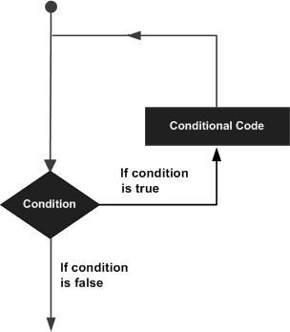
Loops in Java
Loops are used to execute a set of instructions/functions repeatedly when some conditions become true
Types of Iteration statements
For loop
While Loop
Do while Loop

Slide 49
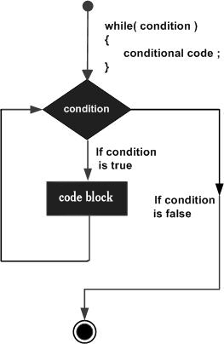
While Loop
It tests the condition before executing the loop body.
Syntax:
while(condition){
//code to be executed
}

Slide 50
Example of while Loop
public class WhileExample {
public static void main(String[] args) {
int i=1;
while(i<=10){
System.out.println(i);
i++;
}
}
}
1
2
3
4
5
6
7
8
9
10

Slide 51
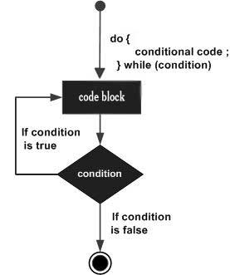
Do While Loop
It tests the condition after executing the loop body.
Syntax:
do{
//code to be executed
}while(condition);

Slide 52
Example of do while Loop
public class Test {
public static void main(String args[]) {
int x = 10;
do {
System.out.print("value of x : " + x );
x++;
System.out.print("\n");
}while( x < 20 );
}
}
value of x : 10
value of x : 11
value of x : 12
value of x : 13
value of x : 14
value of x : 15
value of x : 16
value of x : 17
value of x : 18
value of x : 19

Slide 53
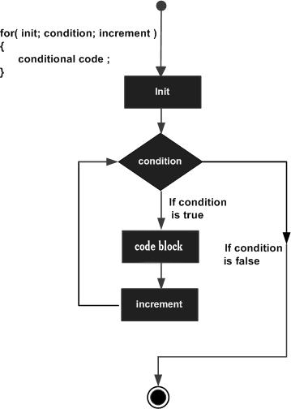
For Loop
Syntax:
for(initialization;condition;incr/decr){
//statement or code to be executed
}

Slide 54
Example of For Loop
public class ForExample {
public static void main(String[] args) {
for(int i=1;i<=10;i++){
System.out.println(i);
}
}
}
1
2
3
4
5
6
7
8
9
10

Slide 55
For Each Loop
The for-each loop is used to traverse array or collection in java.
Syntax:
for(Type var:array/collection){
//code to be executed
}
public class ForEachExample {
public static void main(String[] args) {
//Declaring an array
int arr[]={12,23,44,56,78};
//Printing array using for-each loop
for(int i:arr){
System.out.println(i);
}
}
}
12
23
44
56
78

Slide 56
Let's find the output

Slide 57
Try to find the output of the program
package com;
public class ExampleClass_Day3 {
public static void main(String[] args) {
String username ="Naveen Kumar";
String arr[]={"Naveen Kumar","Bala Suriya","Rajesh","Abhilash"};
for(String str1:arr){
if(str1==username){
System.out.println("Welcome "+username);
}
else{
System.out.println("Please enter a valid user name");
}
}
}
}

Slide 58
Welcome Naveen Kumar
Please enter a valid user name
Please enter a valid user name
Please enter a valid user name

Slide 59
Array in JAVA (Non primitive Datatype)
An array is used to store a collection of data.
It stores a fixed-size sequential collection of elements of the same datatype
There are two types of array.
Single Dimensional Array
Multi Dimensional Array

Slide 60
Types of Array in java
Syntax to Declare Single dimensional Array in java
dataType arrayRefVar[] = new dataType[arraySize];
Eg. String arr[] = new String [5];
Syntax to Declare Multidimensional Array in java
dataType arrayRefVar[][] = new dataType[m][n];
eg.String arr1[][]=new String[3][2];

Slide 61
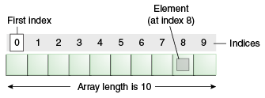
How elements are stored in a Array?

Slide 62
Example of Single Dimentional Array
class Testarray{
public static void main(String args[]){
int a[]=new int[5];//declaration and instantiation
a[0]=10;//initialization
a[1]=20;
a[2]=70;
a[3]=40;
a[4]=50;
for(int i=0;i<a.length;i++)//length is the property of array
System.out.println(a[i]);
}}
10
20
70
40
50

Slide 63
Example of MultiDimensional Array
class Testarray3{
public static void main(String args[]){
int arr[][]={{1,2,3},{2,4,5},{4,4,5}};
for(int i=0;i<3;i++){
for(int j=0;j<3;j++){
System.out.print(arr[i][j]+" ");
}
System.out.println();
}
}}
1 2 3
2 4 5
4 4 5

Slide 64
Scanner Class in JAVA
java.util package
To read input from the keyboard, the java.util.Scanner is used
Java Scanner Class provides many methods to read and parse the input values from the user
To use the Scanner class methods to read the input we should create an object of Scanner Class

Slide 65
Example of Scanner Class
package com;
import java.util.*;
public class ScannerClassExample1 {
public static void main(String args[]){
Scanner scan = new Scanner(s);
System.out.print("Enter your name: ");
String name = in.next();
System.out.println("Name: " + name);
}}
Enter your name: Abhishek
Name: Abhishek

Slide 66
Try it out
Try to build a program for a bank ATM which allows the customer to withdraw and check status of his Savings Account
Use a default Data as shown in table.
Rules to be followed.
Username & Password Validation
The customer should maintain a minimum balance of Rs.500 in his savings account
Declare Name ,Cash and Password in Arrays and try to iterate using index
Name | Availble Cash in Rupees | Password
John Steward | 45689 | John
Naveen Kumar | 158562 | Naveen
Vinay Kumar | 145269 | Kumar

Slide 67
Recall
Looping Statements in java
For loop and For each loop
While loop and Do while loop
Array Datatype in java
Single and Multi dimensional array
Scanner class

Slide 68
OOPS Concept in java
Object-Oriented Programming is a methodology to design a program using classes and objects
It binds data more closely to the functions and protects them from unintentional alteration by other functions.
OOP allows programmers to break down a problem into the number of entities called Objects and then build data and functions around these entities

Slide 69
Concepts in OOPS
Classes and Objects
Data Abstraction
Data encapsulation
Inheritance
Polymorphism
Dynamic Binding

Slide 70
Classes and Objects

Slide 71
What is Class?
A class is a template or blueprint that is used to create objects.
A class consists of Data members and methods
The primary purpose of a class
to hold data/information using data members
The member functions determine the behavior of the class

Slide 72
Syntax of Class
public class class_name
{
Data Members;
Methods;
}
eg. public class Animal
{
int data;int data2;
display();
}

Slide 73
Objects in java
Real-world Objects - cars, dogs, humans, etc.
A car,
Its state is - name, brand, color
The behavior is - Starting,running and Stoping.
Software objects also have State and Behaviour
State is store in fields/data members
Behaviour is shown through methods

Slide 74
Syntax for Object creation
ClassName referencevariablename = new Constructor();
eg. Car c1 = new Car();
c1.speed;
c1.start();
c1.stop();

Slide 75
Functions /Methods in Java
A Java method is a collection of statements that are grouped together to perform an operation.
Advantages of function
Code Reusability
Code Optimization
Method declaration in java
Syntax :
modifier returntype methodName(list of parameters) {
// body
}
eg.public static int methodName(int a, int b) {
}

Slide 76
Method Calling
For using a method, it should be called.
There are two ways in which a method is called
Method returns a value
Returning nothing (no return value).
When a program invokes a method, the program control gets transferred to the called method.

Slide 77
Types of functions based on return type
This called method then returns control to the caller in two conditions, when
The return statement is executed.
It reaches the method ending closing brace.
public void display(){ public String display(){
System.out.println(); return “hello”;
} }

Slide 78
The void Keyword
The void keyword allows us to create methods which do not return a value.
public static void main(String[] args) {
System.out.println(“This is an example for Void”);
}
One of the best example of void is our main method defined

Slide 79
Constructor in java
Constructor is used to initilizes the object immediately when its is created
Construct executes only ones in object lifecycle
Constructor will have the same name as the class name
It can accept some arguments.
No return type for constructor. Not even void

Slide 80
Default Constructor
class car{
int price;
int maxspeed;
}
Compiler genereates a no argument constructor only when no other constructor is defined in the class.
Car c1=new Car();

Slide 81
Default constructor has the same access as the class itself
No arguments will be present in the default constructor.
eg.
car(){
super();
}

Slide 82
Modifiers in JAVA
Types of Modifiers
Access control modifier
Non-access modifier
Access control modifier
There are four access modifiers available in Java, used to set access levels for classes, variable methods and constructor.

Slide 83
Types of Access modifiers
public
default
private
protected

Slide 84
Access modifiers when used with class
Public
Visible to all classes inside & outside the package
Import statement is required for oustside package classes
Default
no keyword
Visible inside the same package.
Private and Protected
Not applicable to class level declaration.

Slide 85
Recall
OOPS
Classes and objects
Methods/functions
Method calling and type of functions
Constructor
Parameterized and Non Parameterized Constructor
Default Constructor
Access Modifier for classes

Slide 86
Access modifiers with members and function
Public
Visible inside and outside the package
Default
Visible inside the same package
Protected
Visible inside all class inside the same package
Members can be accessed outside the package by inheritance and not by creating an instance.
Private
Visible inside same class inside same package.

Slide 87
Try it out
Visiblity
From the Same Class
From a class in Same package
From a Class Outside the package
From a subclass in the same package
From a subclass outside the package

Slide 88
Java Non Access Modifiers
Final
Static
Abstract
strictfp
native
synchronized
transient
volatile

Slide 89
Final
Final can be applied for classes,methods,instance variables,local variables.
A class marked final cannot be extended
A method marked final cannot be overridden
Object if declared final will not change its value.

Slide 90
Static
Static can be applied for methods and variables
A method or variable marked as static belongs to a class file
A static member should be accessed using class name.
To invoke non static memebers we need to use instance of that class
Static variable if once changed will reflect in all instances of the class.
Members marked as static can be final

Slide 91
Example for Static
public class ford{
public void printInfo(){
System.out.println(“Ford1360);
System.out.println(“Maxspeed is 2600 rpm”);
System.out.println(“Engine capacity is 3000cc);
}}
public class ShowRoom{
publicvoid getCarInfo(){
ford f1=new ford();
f1.printInfo();
}}

Slide 92
public class ford{
public static void printInfo(){
System.out.println(“Ford1360);
System.out.println(“Maxspeed is 2600 rpm”);
System.out.println(“Engine capacity is 3000cc);
}
public class ShowRoom{
publicvoid getCarInfo(){
ford.printInfo();
}
}

Slide 93
Recall
Access Modifiers
public
private
protected
default
Non Access Modifiers
final
static

Slide 94
Inheritance in JAVA
Inheritance in Java is a mechanism in which one object acquires all the properties and behaviors of a parent object.
Inheritance represents the IS-A relationship which is also known as a parent-child relationship.
Class: A class is a group of objects which have common properties. It is a template or blueprint from which objects are created.

Slide 95
Sub Class/Child Class: Subclass is a class which inherits the other class. It is also called a derived class, extended class, or child class.
Super Class/Parent Class: Superclass is the class from where a subclass inherits the features. It is also called a base class or a parent class.
Reusability: Reusability is a mechanism which facilitates you to reuse the fields and methods of the existing class when you create a new class

Slide 96
Syntax for inheritance
class Subclass-name extends Superclass-name
{
//methods and fields
}
eg.
class ford extends Car{
void printInfo();
}

Slide 97
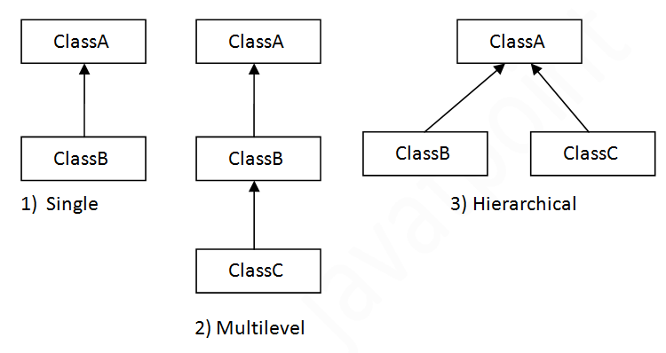
Types of inheritance in java

Slide 98
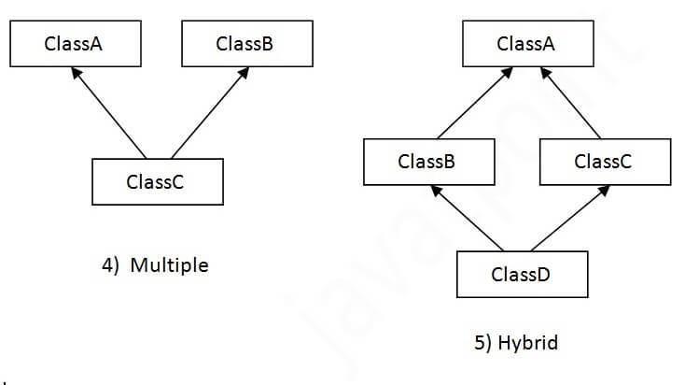
Inheritance not supported

Slide 99
Single Inheritance Example
class Animal{
void eat(){System.out.println("eating...");}
}
class Dog extends Animal{
void bark(){System.out.println("barking...");}
}
class TestInheritance{
public static void main(String args[]){
Dog d=new Dog();
d.bark();
d.eat();
}}
barking...
eating...

Slide 100
Multilevel Inheritance Example
class Animal{
void eat(){System.out.println("eating...");} }
class Dog extends Animal{
void bark(){System.out.println("barking...");} }
class BabyDog extends Dog{
void weep(){System.out.println("weeping...");} }
class TestInheritance2{
public static void main(String args[]){
BabyDog d=new BabyDog();
d.weep();
d.bark();
d.eat();
}}
weeping...
barking...
eating...

Slide 101
Hierarchical Inheritance Example
class Animal{
void eat(){System.out.println("eating...");} }
class Dog extends Animal{
void bark(){System.out.println("barking...");} }
class Cat extends Animal{
void meow(){System.out.println("meowing...");} }
class TestInheritance3{
public static void main(String args[]){
Cat c=new Cat();
c.meow();
c.eat();
}}
meowing...
eating...

Slide 102
Why multiple inheritance is not supported in java?
class A{
void msg(){System.out.println("Hello");}
}
class B{
void msg(){System.out.println("Welcome");}
}
class C extends A,B{
Public Static void main(String args[]){
C obj=new C();
obj.msg();//Now which msg() method would be invoked?
}
}
Compile Time Error

Slide 103
Referencing Subclass objects
There are two approaches to refer a subclass object.
First approach (Referencing using Superclass reference): A reference variable of a superclass can be used to a refer any subclass object derived from that superclass. If the methods are present in SuperClass, but overridden by SubClass, it will be the overridden method that will be executed.
Second approach (Referencing using subclass reference) : A subclass reference can be used to refer its object.

Slide 104
Try it out
Referencing Subclass objects
with practical Example

Slide 105
Recall
Inheritance in JAVA Is-a relationship.
extends keyword
Super/parent class, child/sub class
Types of inheritance
Single,Multilevel,Hierarchial
Multiple, Hybrid
Referencing Subclass objects

Slide 106
Polymorphism in JAVA
Polymorphism is derived from 2 Greek words:
poly and morphs.
The word "poly" means many and "morphs" means forms.
Polymorphism is the ability of an object to take on many forms.
The most common use of polymorphism in OOP occurs when a parent class reference is used to refer to a child class object.

Slide 107
Types of polymorphism
There are two types of polymorphism in Java:
compile-time polymorphism and runtime polymorphism.
We can perform polymorphism in java by
method overloading and method overriding.
If you overload a static method in Java, it is the example of compile time polymorphism.

Slide 108
Method Overloading in Java
If a class has multiple methods having same name but different in parameters, it is known as Method Overloading.
Advantage of method overloading
Method overloading increases the readability of the program.
Different ways to overload the method
There are two ways to overload the method in java
By changing number of arguments
By changing the data type

Slide 109
Method Overloading: changing no. of arguments
class Adder{
static int add(int a,int b){return a+b;}
static int add(int a,int b,int c){return a+b+c;}
}
class TestOverloading1{
public static void main(String[] args){
System.out.println(Adder.add(11,11));
System.out.println(Adder.add(11,11,11));
}}
22
33

Slide 110
Method Overloading: changing datatype of args
class Adder{
static int add(int a, int b){return a+b;}
static double add(double a, double b){return a+b;}
}
class TestOverloading2{
public static void main(String[] args){
System.out.println(Adder.add(11,11));
System.out.println(Adder.add(12.3,12.6));
}}
22
24.9

Slide 111
Method Overloading is it possible
by changing the return type of methods?

Slide 112
class Adder{
int add(int a,int b){return a+b;}
double add(int a,int b){return a+b;}
}
class TestOverloading3{
public static void main(String[] args){
Adder ad=new Adder();
System.out.println(ad.add(11,11));//ambiguity
}}
Compile Time Error: method add(int,int)
is already defined in class Adder

Slide 113
Can we overload
java main() method?

Slide 114
Yes, by method overloading. You can have any number of main methods in a class by method overloading. But JVM calls main() method which receives string array as arguments only.
class TestOverloading4{
public static void main(String[] args){System.out.println("main with String[]");}
public static void main(String args){System.out.println("main with String");}
public static void main(){System.out.println("main without args");}
}

Slide 115
Method Overriding in Java
If subclass (child class) has the same method as declared in the parent class, it is known as method overriding in Java
Usage of Java Method Overriding
Method overriding is used to provide the specific implementation of a method which is already provided by its superclass.
Method overriding is used for runtime polymorphism

Slide 116
Rules for Java Method Overriding
The method must have the same name as in the parent class
The method must have the same parameter as in the parent class.
There must be an IS-A relationship (inheritance).

Slide 117
class Vehicle{
void run(){System.out.println("Vehicle is running");} }
class Bike2 extends Vehicle{
void run(){System.out.println("Bike is running safely");}
public static void main(String args[]){
Bike2 obj = new Bike2();
obj.run();
} }
Bike is running safely

Slide 118
Can you answer?

Slide 119
Can we override static method?
Why can we not override static method?
Can we override java main method?
Is Constructor overloading possbile?
Is Constructor overriding possible?

Slide 120
Try it out
Demo
Create a paren class Bank
Create sub classes SBI,ICICI,HDFC
Overide the rate of interest provide by each bank
Demo1
Create a class Area
Create sub classes Rectangle,Triangle,Circle,Square
Overload a method to find area and perimeter
Use Scanner class as mandatory for above two

Slide 121
Recall
Polymorphism in JAVA
Types of polymorphism
Runtime and compiletime polymorphism
method overloading
method overridding
Can we override static method?
Why can we not override static method?
Can we override java main method?
Is Constructor overloading possbile?
Is Constructor overriding possible?

Slide 122
Java - Abstraction
Abstraction is a process of hiding the implementation details from the user, only the functionality will be provided to the user
The user will have the information on what the object does instead of how it does it.
In Java, abstraction is achieved using Abstract classes and interfaces.

Slide 123
Abstact
public class Car(){
public void move(){
System.out.println(“Moves at 40kmph”);
}
}
public abstract class Car(){
public abstract void move();
}

Slide 124
Abstract rules for Classes
Abstract can be applied for classes and methods only
A class can be abstract without any methods in it
Abstact class can have non abstact methods in it
We cannot create an instance of abstract class
Abstract classes cannot be marked as final

Slide 125
Abstract rules for methods
Abstract methods cannot be marked as final
An abstract method in sub class should be overridden or marked as abstract
When a method is marked as abstract it should not have implementation
Abstract method should end with ; and not with { }
Abstract cannot be mixed with static and private.

Slide 126
Real time example

Slide 127
Interface in JAVA
Interface does not have any method implementataion
All methods in inerface are abstract and public
Any Data members that is declared is public, final and static even if we dont declare them
Syntax:
Access modifier interface intce_Name{
// Data members and methods
}

Slide 128
Why we need Interface??
No multiple inheritance in java
Any object needs a IS-A relationship with many types
Public interface President{ public interface Father{
public abstract void winPOll(); public void care();}
}
public ineterface politician{ public class Citizen{
public abstract void party();
} }

Slide 129
Implementing Multiple inheritance using interface
public class Obama extends Citizen implements President,Politician,Father{
}

Slide 130
Rules
All methods o interface are abtract and should be overiden in sub classes
public interface President{
public abstract void winPOll();}
public class Obama implements President {
public void winPoll(){
System.out.println(“Won in election”);
}}

Slide 131
Interface can extend any number of interfaces
Syntax
Concrete and abstract classes implement interface.
public interfaceCar extends Vehicle,fourWheeler{
}

Slide 132
Recall
Abstraction in java
How Abstraction can be acheived?
Abstract class
Non abstract and abstract methods
Interface
Only abstract methods even if it is not declared.
Multiple inheritance in java

Slide 133
Aggregation in Java
If a class have an entity reference, it is known as Aggregation.
HAS-A relationship.
When use Aggregation?
Code reuse is also best achieved by aggregation when there is no is-a relationship.
Inheritance should be used only if the relationship is-a is maintained throughout the lifetime of the objects involved; otherwise, aggregation is the best choice.

Slide 134
public class Emp {
int id; String name; Address address;
public Emp(int id, String name,Address address) {
this.id = id; this.name = name; this.address=address; }
void display(){
System.out.println(id+" "+name);
System.out.println(address.city+" "+address.state+" "+address.country); }
public static void main(String[] args) {
Address address1=new Address("gzb","UP","india");
Address address2=new Address("gno","UP","india");
Emp e=new Emp(111,"varun",address1);
Emp e2=new Emp(112,"arun",address2);
e.display(); e2.display();
} }

Slide 135
111 varun
gzb UP india
112 arun
gno UP india

Slide 136
Collections in JAVA

Slide 137
Collections in java
Collection in Java is a framework that provides an architecture to store and manipulate the group of objects
All the operations that you perform on a data such as searching, sorting, insertion, manipulation, deletion, etc. can be achieved by Java Collections
Java Collection means a single unit of objects. Java Collection framework provides many interfaces (Set, List, Queue, Deque, etc.) and classes (ArrayList, Vector, LinkedList, PriorityQueue, HashSet, LinkedHashSet, TreeSet, etc.)

Slide 138
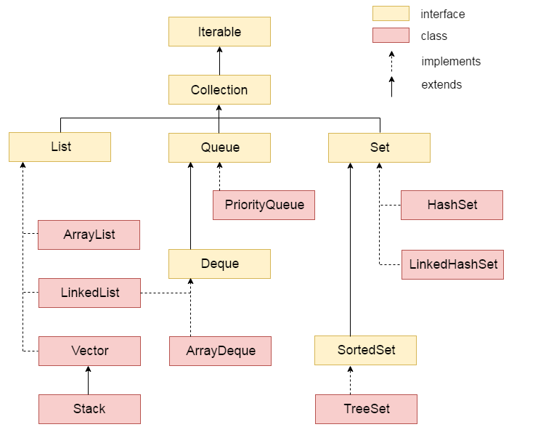
Hierarchy of collections

Slide 139
Java ArrayList class
Java ArrayList class uses a dynamic array for storing the elements
Java ArrayList class can contain duplicate elements.
Java ArrayList class maintains insertion order.
In Java ArrayList class, manipulation is slow because a lot of shifting needs to be occurred if any element is removed from the array list.

Slide 140
Example of ArrayList
import java.util.*;
class TestCollection1{
public static void main(String args[]){
ArrayList<String> list=new ArrayList<String>();//Creating arraylist
list.add("Ravi");//Adding object in arraylist
list.add("Vijay"); list.add("Ravi");
list.add("Ajay");
Iterator itr=list.iterator();
while(itr.hasNext()){
System.out.println(itr.next());
} } }
Ravi
Vijay
Ravi
Ajay

Slide 141
There are two ways to traverse collection elements:
By Iterator interface.
By for-each loop.

Slide 142
Iterating Collection through for-each loop
import java.util.*;
class TestCollection2{
public static void main(String args[]){
ArrayList<String> al=new ArrayList<String>();
al.add("Ravi"); al.add("Vijay");
al.add("Ravi"); al.add("Ajay");
for(String obj:al)
System.out.println(obj);
} }
Ravi
Vijay
Ravi
Ajay

Slide 143
User-defined class objects in Java ArrayList
class Student{
int rollno;
String name;
int age;
Student(int rollno,String name,int age){
this.rollno=rollno;
this.name=name;
this.age=age;
}
}

Slide 144
import java.util.*;
public class TestCollection3{
public static void main(String args[]){
Student s1=new Student(101,"Sonoo",23);
Student s2=new Student(102,"Ravi",21);
ArrayList<Student> al=new ArrayList<Student>();
al.add(s1); al.add(s2);
Iterator itr=al.iterator();
while(itr.hasNext()){
Student st=(Student)itr.next();
System.out.println(st.rollno+" "+st.name+" "+st.age); } } }
101 Sonoo 23
102 Ravi 21

Slide 145
Java HashMap class
It inherits Abstract Map class and implements Map interface.
The important points about Java HashMap class are:
A HashMap contains values based on the key.
It contains only unique elements.
It may have one null key and multiple null values.
It maintains no order.

Slide 146
import java.util.*;
class TestCollection13{
public static void main(String args[]){
HashMap<Integer,String>hm=newHashMap<Integer,String>();
hm.put(100,"Amit"); hm.put(101,"Vijay"); hm.put(102,"Rahul");
for(Map.Entry m:hm.entrySet()){
System.out.println(m.getKey()+" "+m.getValue());
} } }
102 Rahul
100 Amit
101 Vijay

Slide 147
Exception Handling
in JAVA

Slide 148
Will this code execute perfectly?
package com;
import java.util.Scanner;
Class Dog {
public static void main(String a[]){
Scanner sc = new Scanner(System.in);
System.out.println(“Enter a number ”);
int a=sc.nextInt();
System.out.println(“Number :”+a);
} }

Slide 149
The Exception Handling in Java is one of the powerful mechanism to handle the runtime errors so that normal flow of the application can be maintained.
Types of Java Exceptions According to Oracle, there are three types of exceptions
Checked Exception
Unchecked Exception
Error

Slide 150
The classes which directly inherit Throwable class except RuntimeException and Error are known as checked exceptions e.g. IOException, SQLException etc. Checked exceptions are checked at compile-time.
The classes which inherit RuntimeException are known as unchecked exceptions e.g. ArithmeticException, NullPointerException, ArrayIndexOutOfBoundsException etc. Unchecked exceptions are not checked at compile-time, but they are checked at runtime.
Error is irrecoverable e.g. OutOfMemoryError, VirtualMachineError, AssertionError etc.

Slide 151
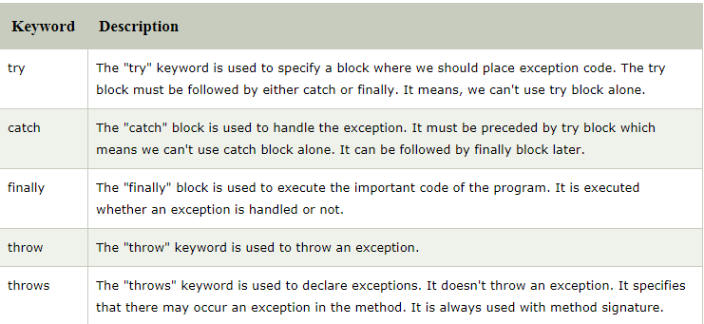
Keywords in exception handling
There are 5 keywords which are used in handling exceptions in Java.

Slide 152
Let's try in Eclipse

Slide 153
int a=50/0;//ArithmeticException
String s=null;
System.out.println(s.length());//NullPointerException
String s="abc";
int i=Integer.parseInt(s);//NumberFormatException
int a[]=new int[5];
a[10]=50; //ArrayIndexOutOfBoundsException

Slide 154
Thank You

